Slide 1

Business Pitch Deck
E-Commerce Marketplace

Slide 2

E-Commerce Marketplace
E-Commerce Marketplace refers to buying and selling goods or services over the internet. It involves a wide range of products from physical goods to digital items, with online transactions and delivery.
Tag Line of my E-Commerce Marketplace Website :
“Shop Fast, Shop Smart”

Slide 3
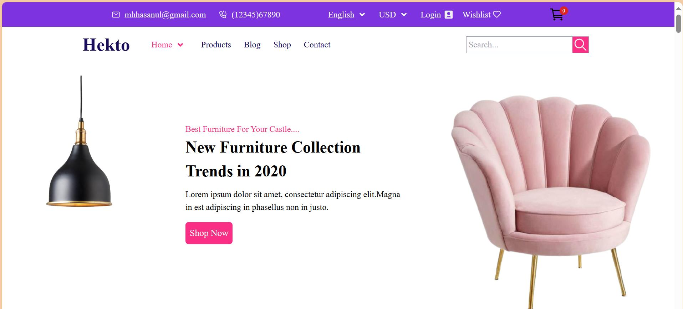
Introduction To My E-Commerce Marketplace Website Platform
Website Overview
This project is an e-commerce platform built using Next.js and Tailwind CSS. It aims to provide a seamless and modern shopping experience for users, with features like smooth navigation, responsive design, and optimized performance.

Slide 4
Tech Stack And Objective
Tech Stack:
The tech stack used for this website includes Next.js(a React framework), fast page loads,Tailwind CSS for rapid UI design and Github for version control to track code changes. The site is deployed on versal for fast, serverless hosting.
Objective:
The primary goal of this platform is to enable users to browse products, make purchases, all while enjoying a fast, visually appealing and intuitive experience.

Slide 5
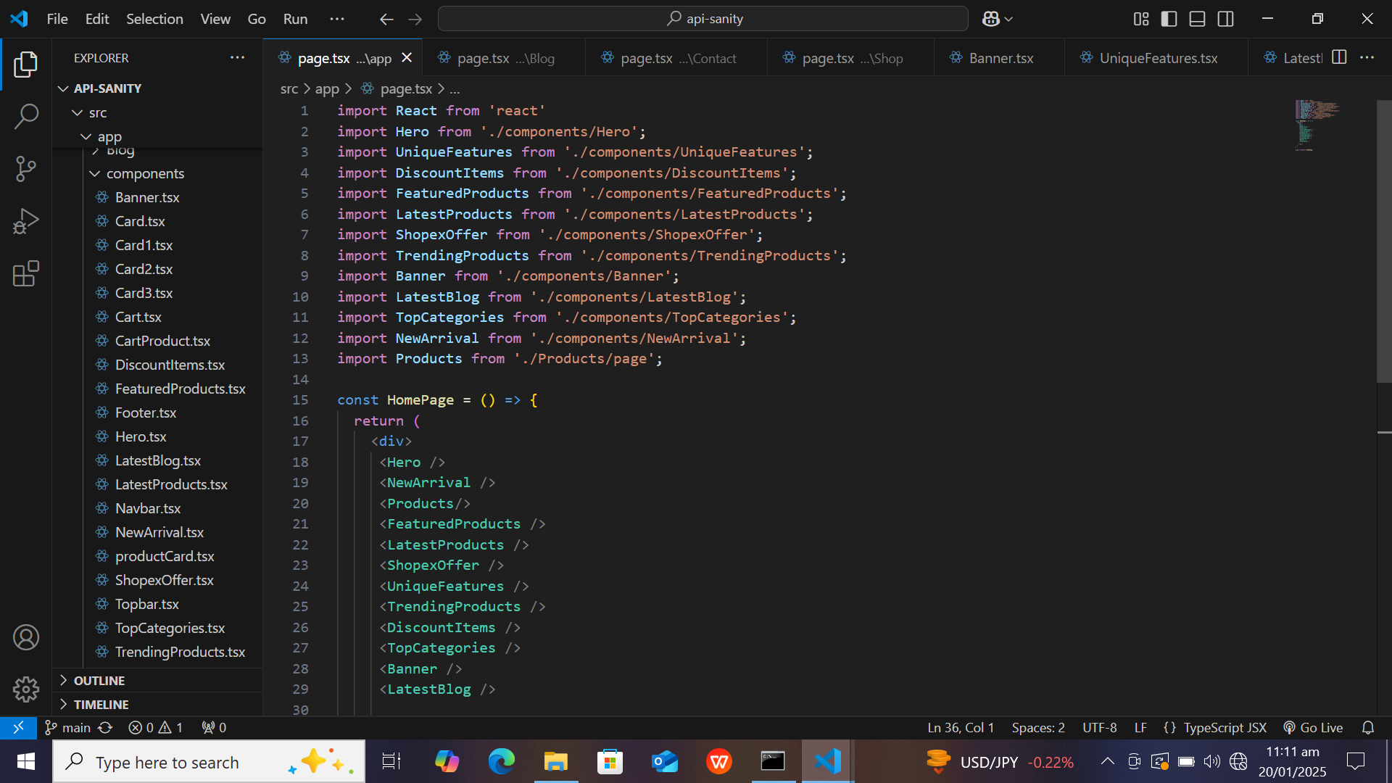
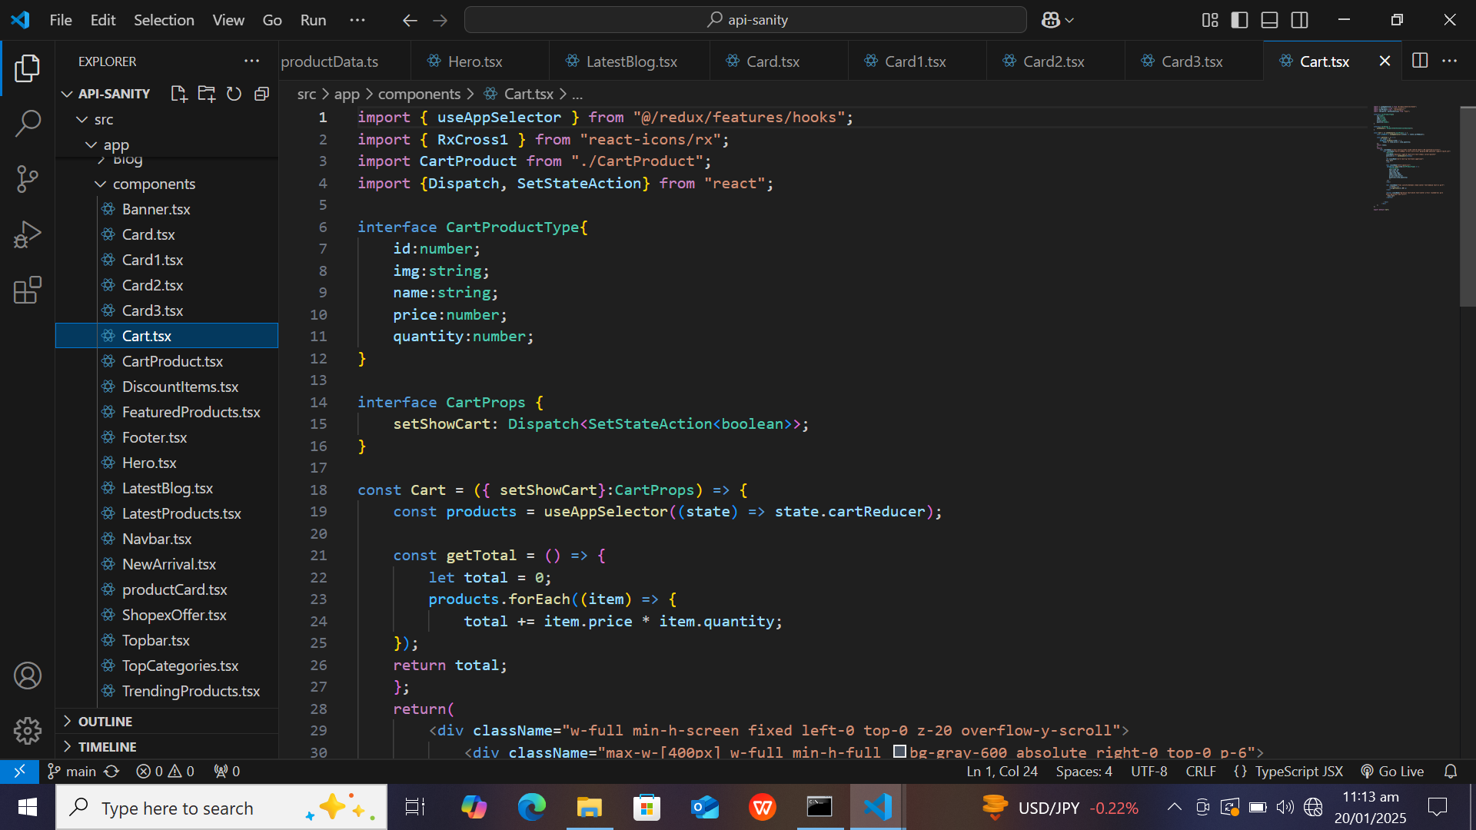
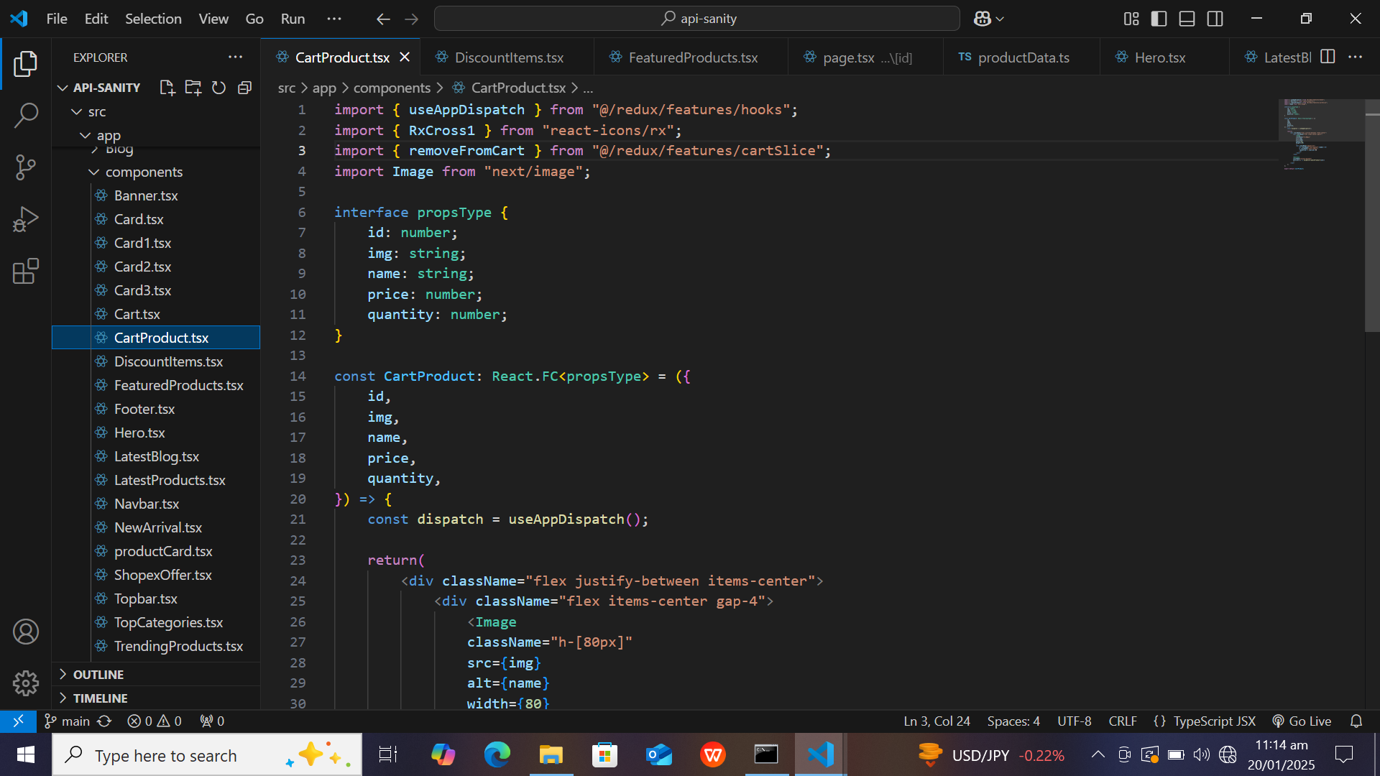
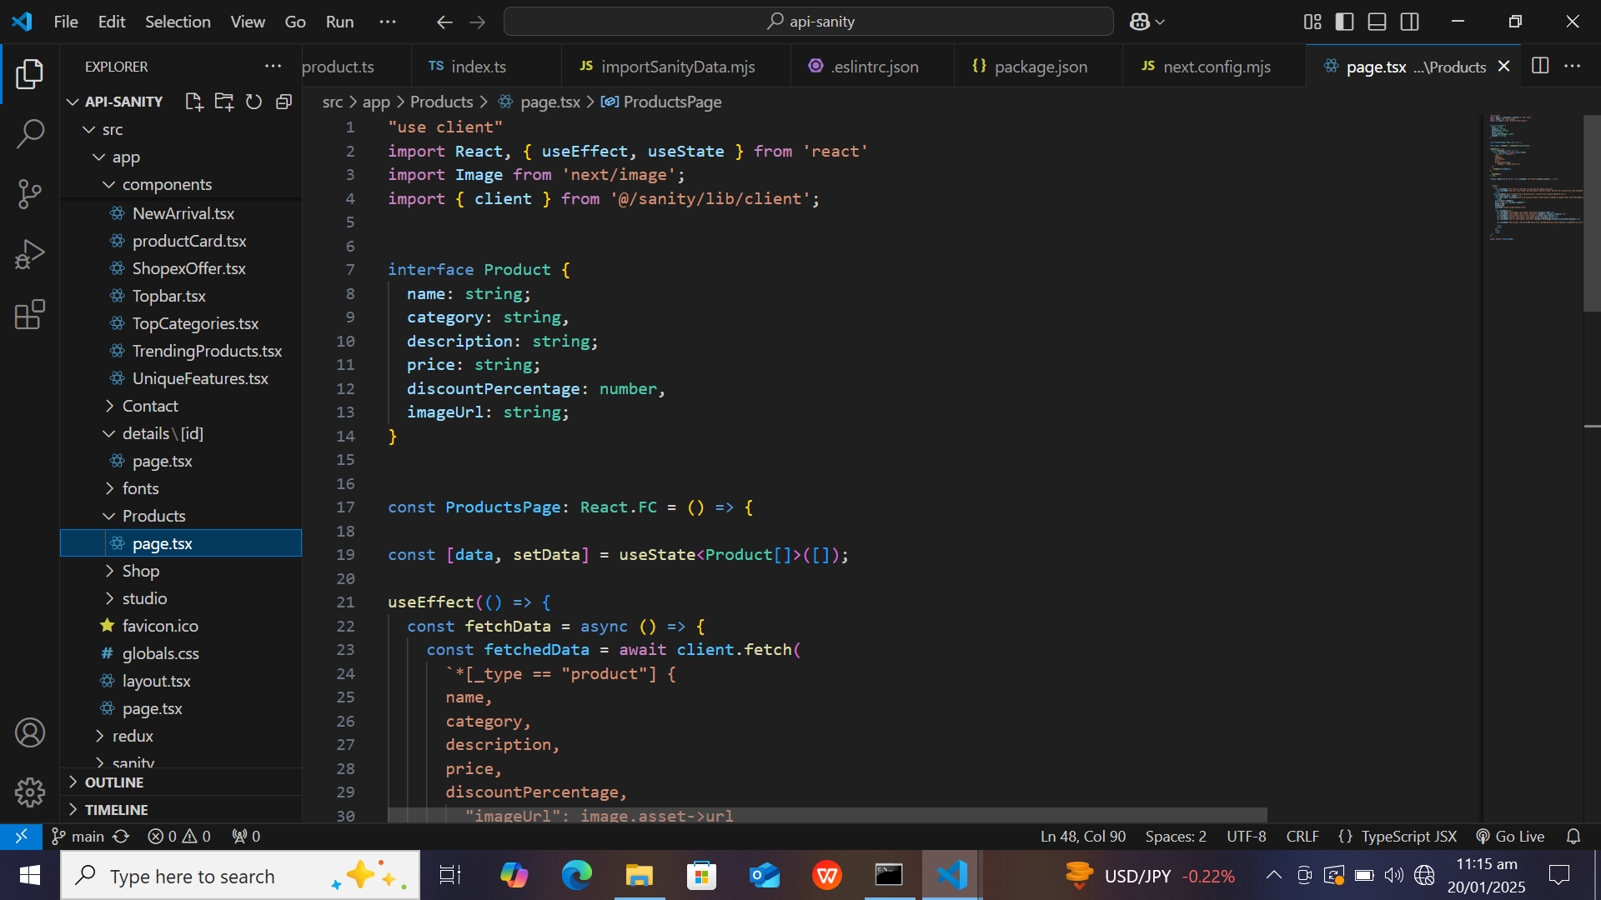
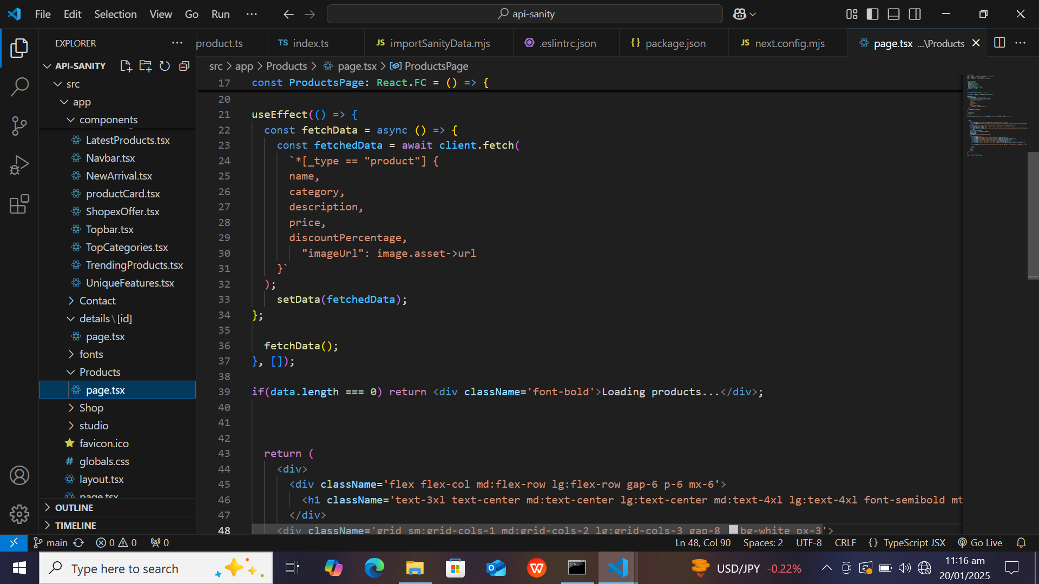
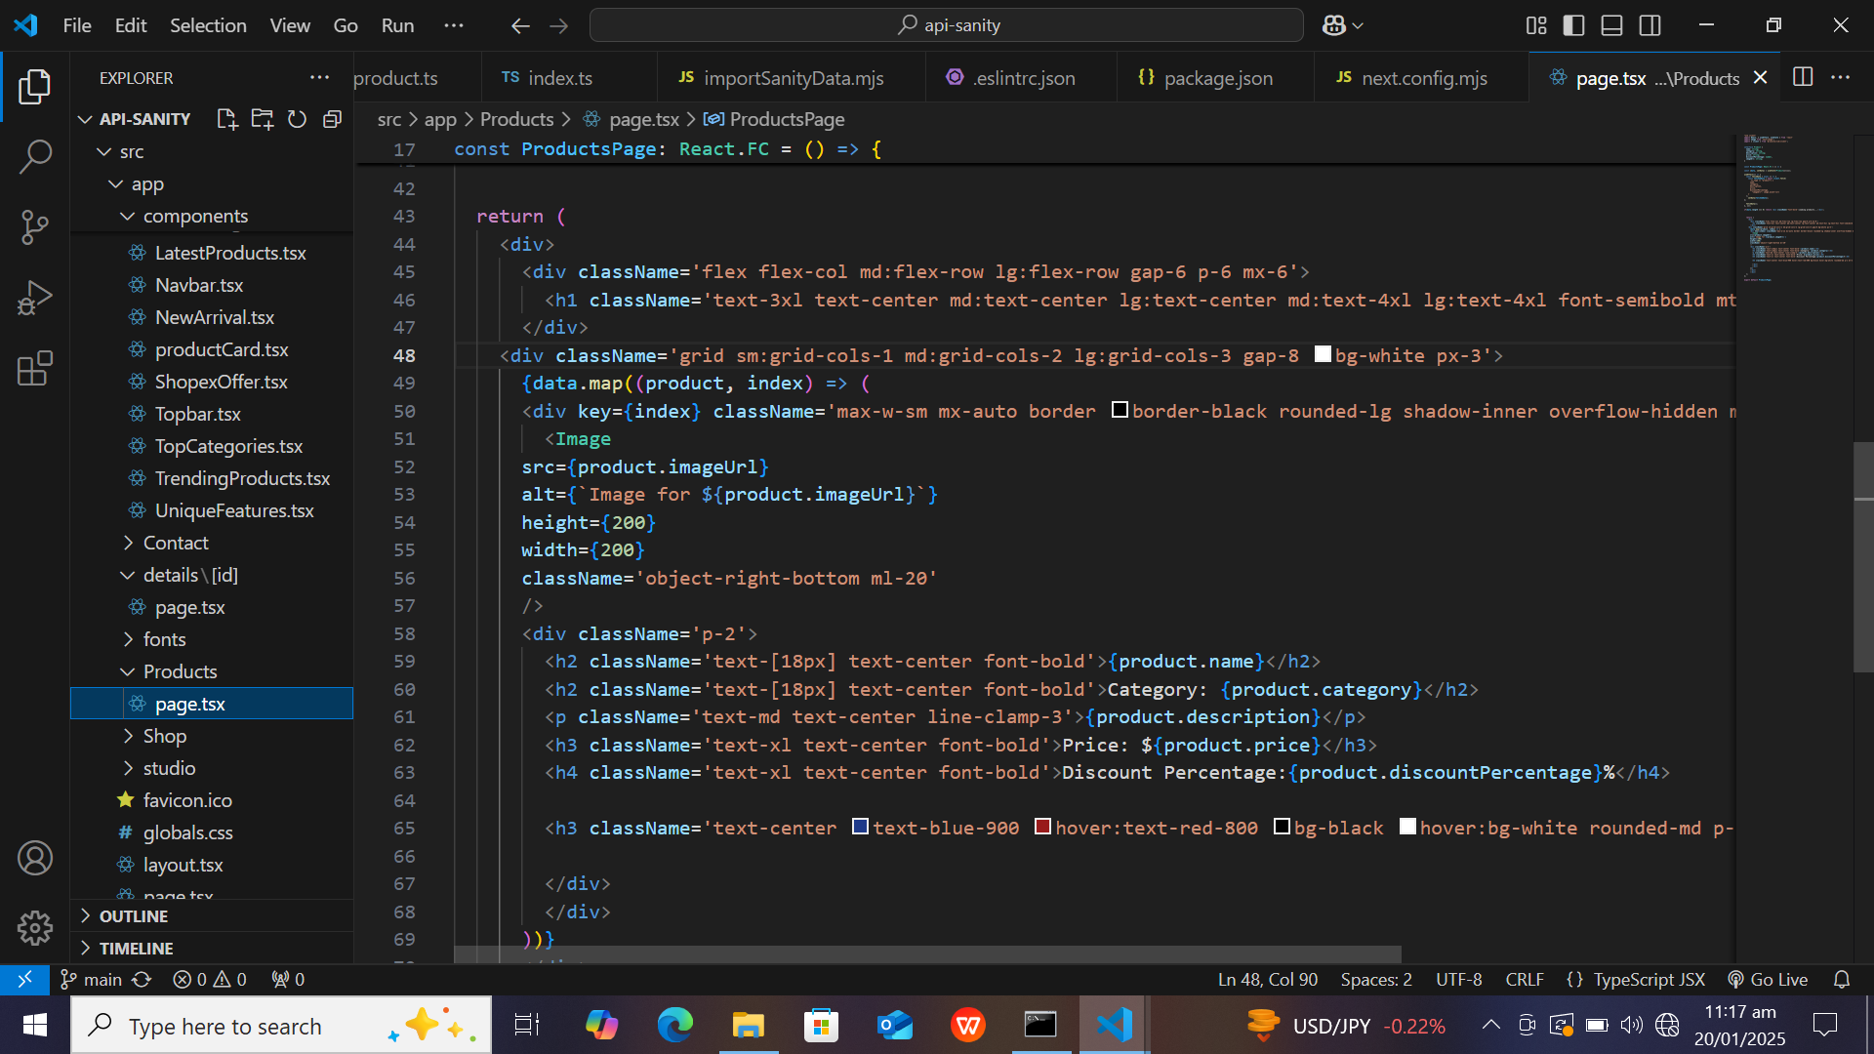

Slide 6
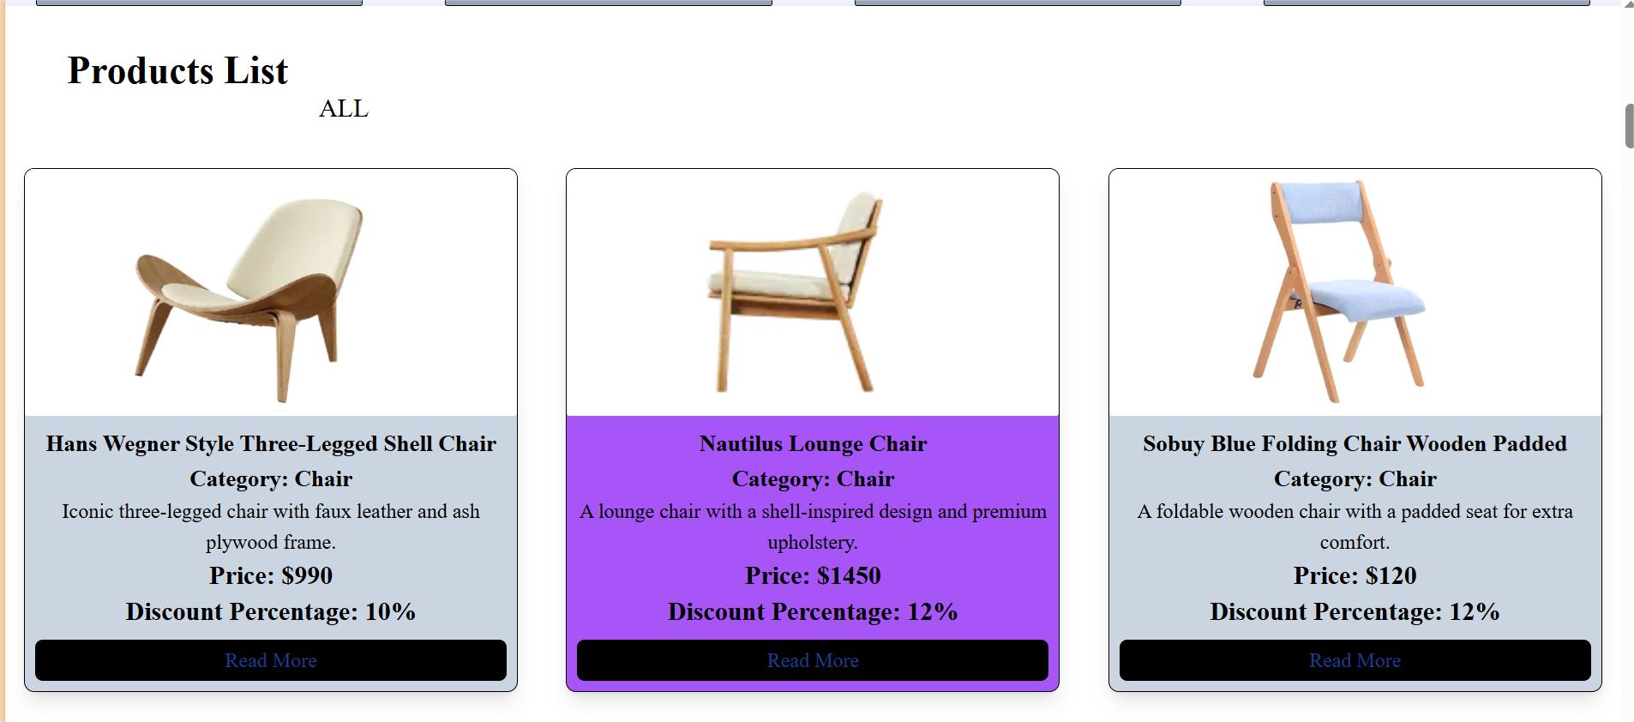

Slide 7
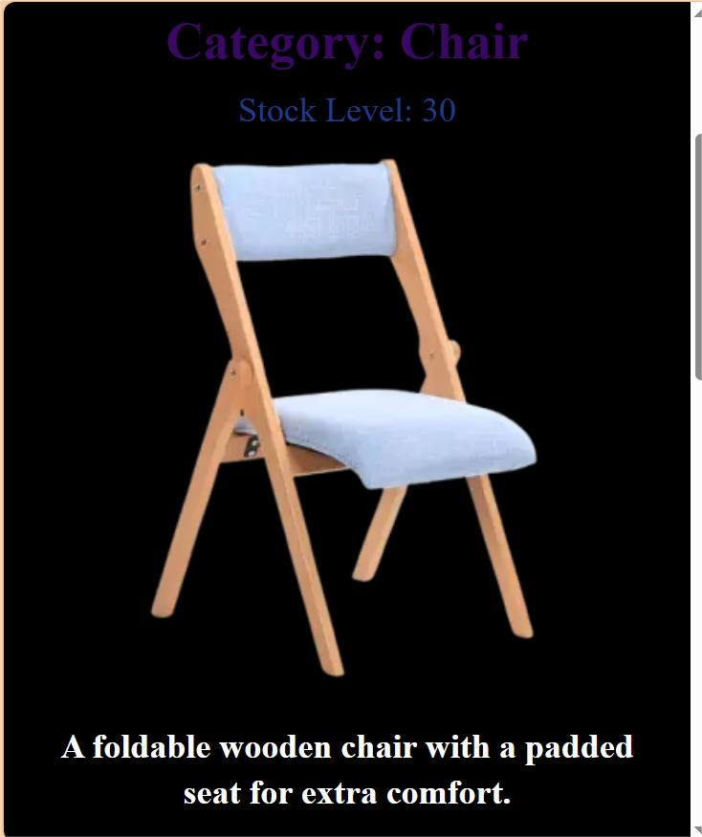

Slide 8
Problem Statement
Problems My Marketplace E-Commerce Website Aim To Solve
This E-Commerce website aims to solve the problem of convenience and accessibility when it comes to purchasing household items. Many customers struggle with finding a reliable, diverse and easily accessible platform. By offering a wide variety of items like home decor, my website will provide a one-stop shop. This will save customers time & the hassle of visiting multiple stores.
Additionally, this platform will offer competitive pricing, product variety and fast delivery options avoiding long shopping times.

Slide 9
Target Audience
Small to medium sized businesses looking to sell online without the need for complex technical infrastructure.
Consumers who demand a modern, fast and easy-to-use online shopping experience.
Individuals or families looking to buy products to furnish, decorate or organize their homes.
Housewives & working women who dont have much time to visit physical shopping marts can purchase online easily.

Slide 10
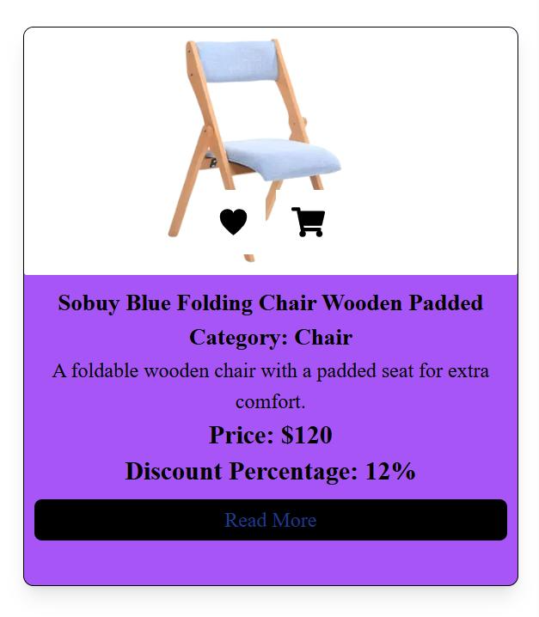
Solution
This E-Commerce website solves all the problems by using Next.js for fast page rendering, Tailwind CSS framework allows for a visually consistent and responsive design , ensuring users have the same smooth experience whether they are on mobile or desktop.
KEY FEATURES
Fast & Responsive Design
Cart Availability
Checkout Process
Secure Payment

Slide 11
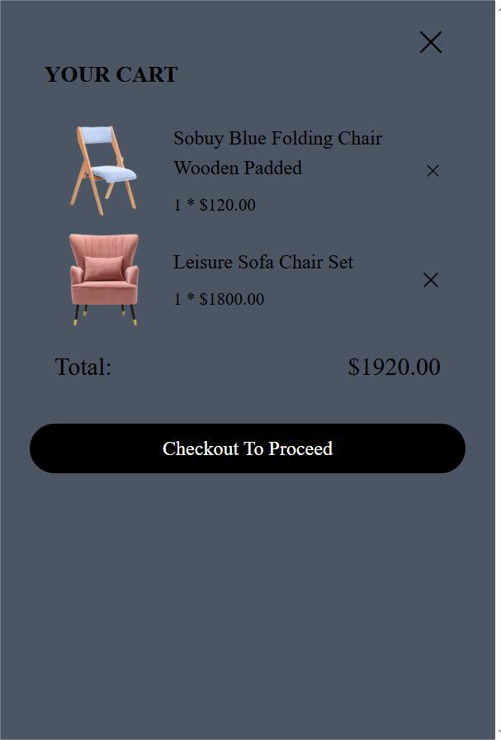
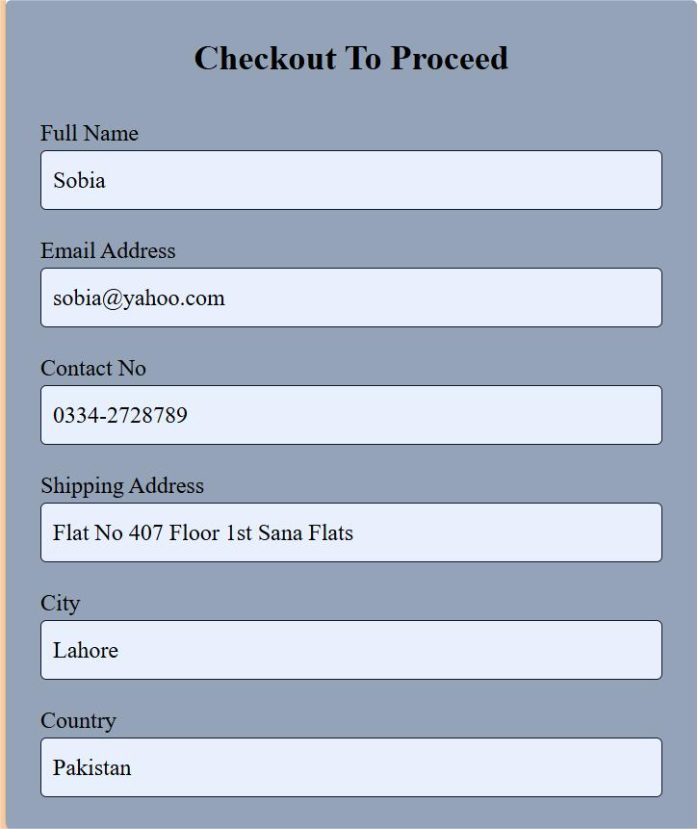
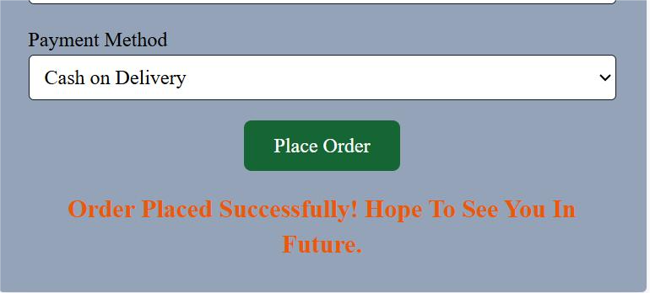

Slide 12
Market Opportunity
E-Commerce Growth
The global e-commerce market is growing exponentially and expected to reach $7 trillion by 2026. The rise of online shopping, increased mobile usage, and changes in consumer behavior are contributing to a rapidly expanding digital marketplace. Businesses are continuously seeking new, innovative solutions to standout.
By focusing on user experience, speed and performance, this platform is well positioned to compete in the market.

Slide 13
Key Trends And Insights
1. Personalized Shopping Experience
Consumers are increasingly looking for personalized recommendations & tailored shopping experience.
2. Sustainability & Ethical Consumption
Sustainable products & eco-friendly packaging are becoming crucial factors in consumer purchasing decisions. Brands & marketplaces focusing on sustainability are seeing higher engagement.
3. Social Commerce
Social media platforms are being used for direct product sales. Features like Instagram shopping and Facebook marketplace are creating new avenues for online sales, especially for small businesses.
4. Faster Delivery
As consumer expectations rise, faster and more flexible delivery options (same day delivery) are becoming an important selling point for e-commerce businesses.

Slide 14
Product - Key Features of My Marketplace E-Commerce Website
1. User-friendly Interface - Easy to use, quick product search, clean simple layout for good shopping experience.
2. Product List - All products displays on home page and users can see detail page by one click on each product.New Arrival and Featured products are also displayed on the home page. Additionally discount percentage is also shown with price of each product.
3. Responsive Design - Fully optimized for all screen sizes, ensuring smooth experience on phones, tablets, and desktops.
4. Secure Payment - Payment options available whether COD(Cash On Delivery) or online payment.
5.Seamless Checkout Process - Quick and easy checkout flow to user by telling basic details.
6. Inventory Updates - Stock Availability is mentioned on each product.
7. Scalable Platform - Serverless hosting with versal automatically handles traffic spikes, ensuring smooth shopping experience even during peak times.

Slide 15
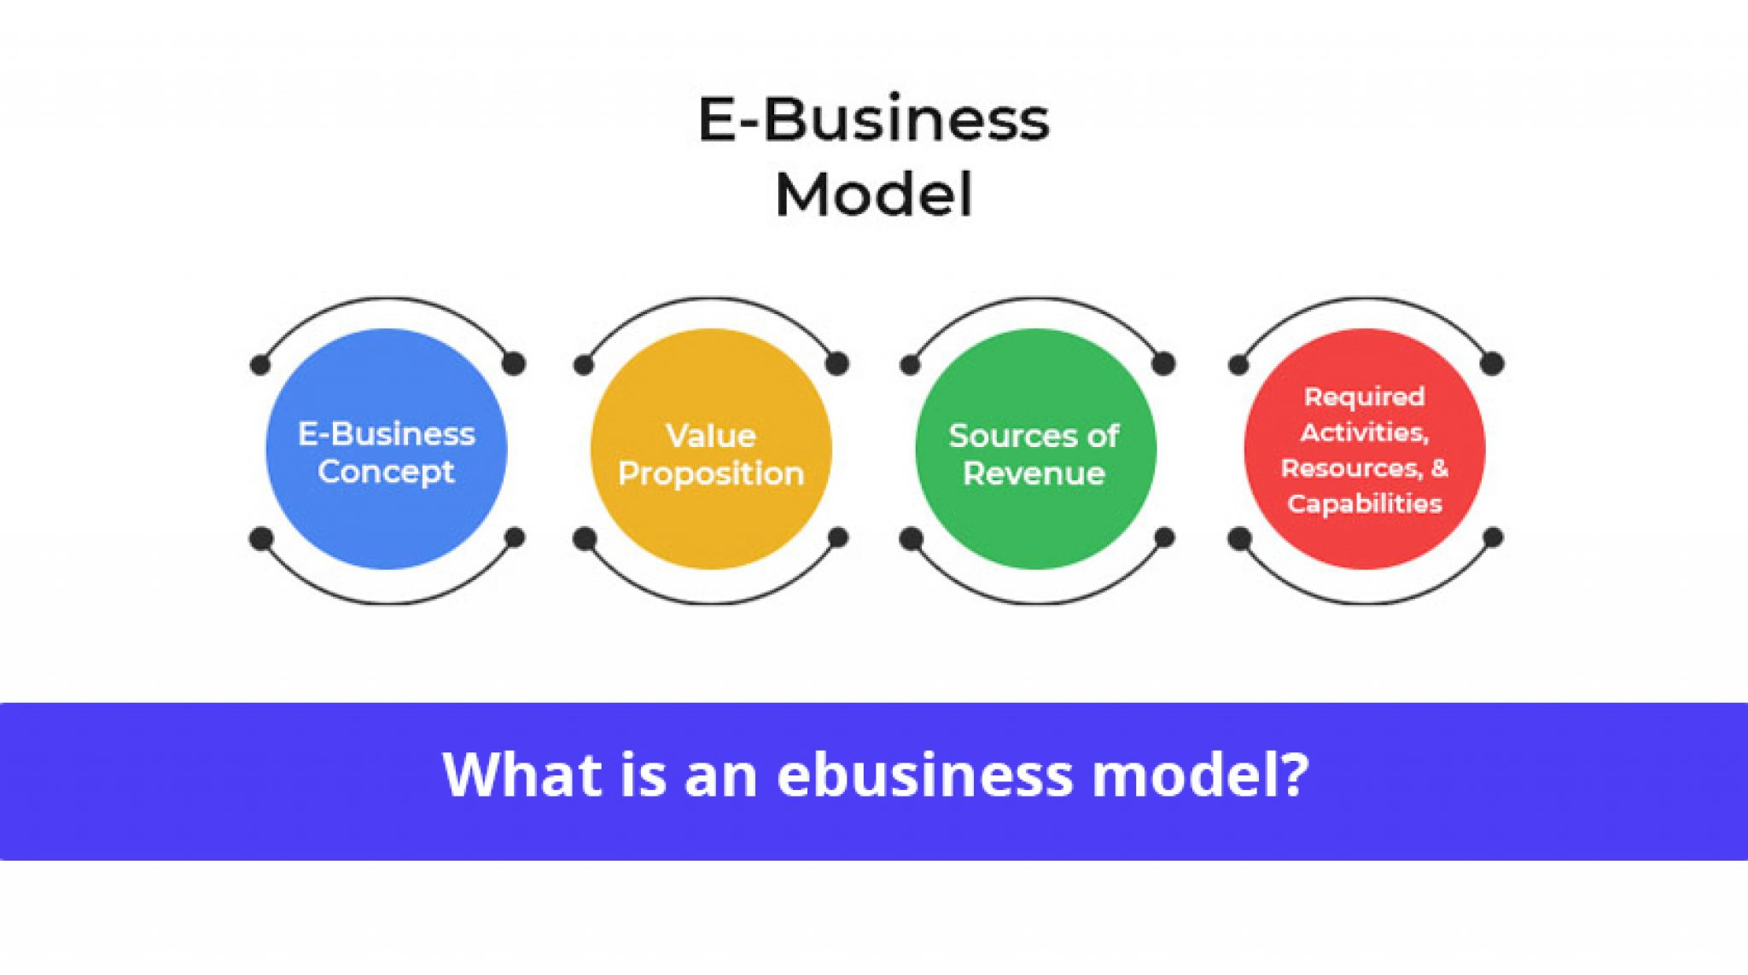
Business Model
Marketplace E-Commerce platform connects sellers of physical products with buyers offering a range of services to facilitate smooth transaction.
Revenue Model includes multiple streams such as:
Commission on sales (Example 10% per sale).
Subscription fees for sellers.
Listing fees (Example $1 per item listed).
Featured Listings/Ads (Example $30 to $50 for product promotion).
Shipping fees (Example platform takes a portion).
Freemium model for buyers(Example The platform offers premium memberships to buyers, providing them with extra benefits like free shipping).

Slide 16
Marketing Strategy
Marketing strategy includes the following:
1. Targeted Advertising & SEO - Optimize for SEO, run social media Ads like Facebook, Instagrams, Whatsapp groups.
2. Partnerships - Collabrate with influencers and brands.
3. Promotions And Discounts - Flash sales and special offers for first time buyers.
4. Loyalty Programs - Reward customers with points and discounts.
5. Customer Service - Provide excellent support with easy returns and fast shipping.
6. Email Marketing - Send personalized offers, abondoned cart reminders and post purchase follow-ups.

Slide 17


My Team includes the following members with their define services:
1. Founder - Oversees the entire business strategy, vision and growth. Also makes high level decisions on every aspect.
2. Product Manager - Define product strategies, work closely with development and design teams to ensure the website meets customer needs and business goals. Manages inventory and ensures products are stocked.
3. Marketing Manager - Leads customer acquisition and retention strategies. Run advertsing
campaigns.
4. Customer Support Team - Provide assistance to customers with any issues regarding orders, returns, shipping or product inquiries.

Slide 18
Financial Projections - Overview For My E-Commerce Website
Revenue Projections
Sales Revenue - I expect to sell atleast 100 - 200 orders/month on initial level and able to generate revenue to bear my business & personal expenses as well.
Commission Fees - By allowing third party vendors, I can charge 10 to 15% commissions on total sales by vendors.
Advertising Revenue - I can offer paid promotions or ads to vendors.
Cost Projections
Marketing & Advertising - Budget for Google Ads, Facebook Ads, influencer partnerships.
Logistics & Shipping - Cost related to shipping, packaging and any fulfillment services.
Employee Salaries - Cost for full time staff. Example: Marketing Manager, Product Manager, Customer Support Team.
Miscellaneous Costs - Any legal fees necessary to run business.

Slide 19
Call To Action
Seeking a Strategic Partnership for full E-Commerce Marketplace Management:
Overview: I have successfully designed and developed the e-commerce website. However, to scale and operate efficiently I am seeking a partnership that can handle both technical and physical aspects of the business.
Technical Support: While the website is designed, I need on going technical support for development, maintenance, bug fixes and adding new features as the business grows. A technical partner with expertise in platform development, integration of payment systems, SEO and continuous optimization.
Physical Support: Managing Logistics, warehousing and fulfilling orders across regions is beyond what I can manage alone. A logistics partner who can help with product storage, packaging, shipping and handling customer returns.

Slide 20
Call To Action
Financial Support: Scaling up the business will require significant financial resources for marketing, inventory and further development. A financial partner or investor who can help cover the costs of expansion, product acquisition and marketing efforts, sharing the financial burden .

Slide 21


